Slide 1






Housing: Density or Sprawl, pick one.
Diana Helm, Clackamas County Commissioner
Mike Mitchell, Oregon City Commissioner
Ben Hemson, Director of Policy and Government Affairs for Home Building Association of Greater Portland
Seth Henderson, Cofounder Level Development NW
Notes:
OCBA – We are a 501c(6), been around for over a decade, have expanded our topics to include those issues impacting all of Clackamas County
Sponsors – Asteria Gardens Senior Living, Petronella Donovan
Elected Officials -
Blue cards
Let’s get to panel introductions. I am an advocate of panelists speaking for themselves, so let’s start with you, Commissioner Helm.

Slide 2
What are we going to discuss today?
Set the table – what are the state’s housing production goals, why, what has our history been of production, who is doing it well.
What has the state passed, how have the underlying municipalities been impacted, what code changes have been incorporated, how have their plans for production changed, do we have any results – is it working? – Clackamas County, City of Oregon City
Compare the impacts on both the public side and the private side. Are these laws getting the desired outcome?

Slide 3
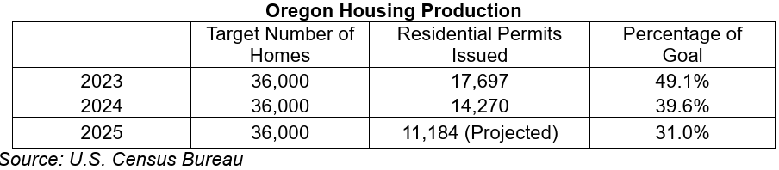
How did we get here and where do we go?
2023, Executive Order 23-04, established Housing Production Advisory Council, goal of 36,000 homes per year for current and future needs.
Current projections (12/03/2025), 29,522 per year for the next decade (move the goal posts).

Slide 4
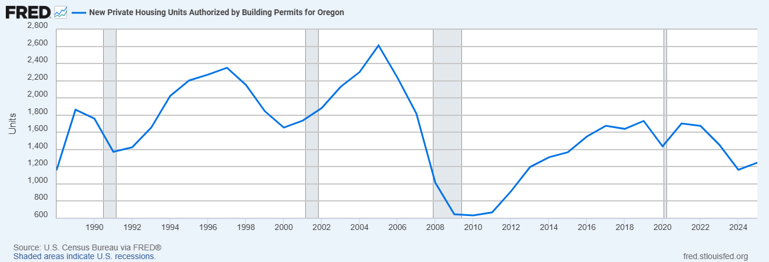
What is the best we have done?
Notes:
FRED – Federal Reserve Bank of St. Louis

Slide 5
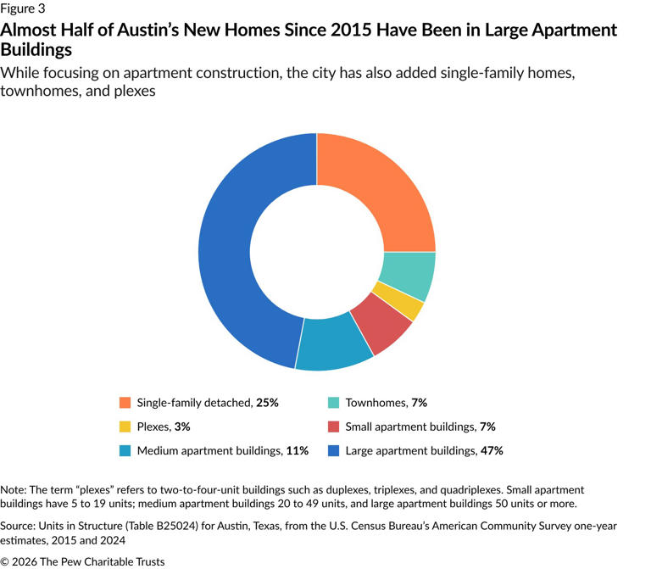
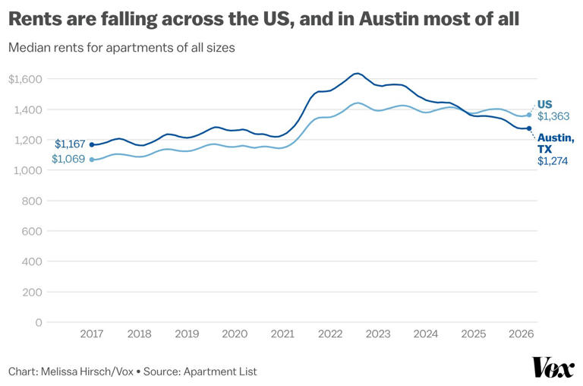
Who is doing it right and what can we learn?
Notes:
2015 to 2024, added 120,000 homes or 30% increase
Updating zoning codes across parts of the city to automatically allow the construction of tall apartment buildings in some places rather than requiring each to go through a long and costly permitting process.
Reducing and later, in 2023, eliminating parking minimums for virtually all new homes. (Elsewhere in the US, parking mandates — i.e., a minimum number of off-street spaces available per unit — make housing more expensive, and sometimes physically impossible, to build.)
Making it significantly easier to build accessory dwelling units (ADUs), which are smaller homes that sit alongside houses on single-family lots.
Allowing up to three homes to be built on lots zoned for single-family houses and greatly cutting down the minimum lot size required to build a single-family home, encouraging builders to add small, less expensive starter homes.
Creating density bonuses that allow developers to build taller in exchange for setting aside some units as income-restricted at lower rents — an approach that, the Pew report notes, has added more market-rate and more affordable apartments.
Last year, Austin’s city council voted to legalize apartment buildings up to five stories built with a single staircase, instead of the two staircases required by default in most US building codes — a longtime YIMBY holy grail because it can drop the cost of new buildings and open up more space and unit layout flexibility.

Slide 6
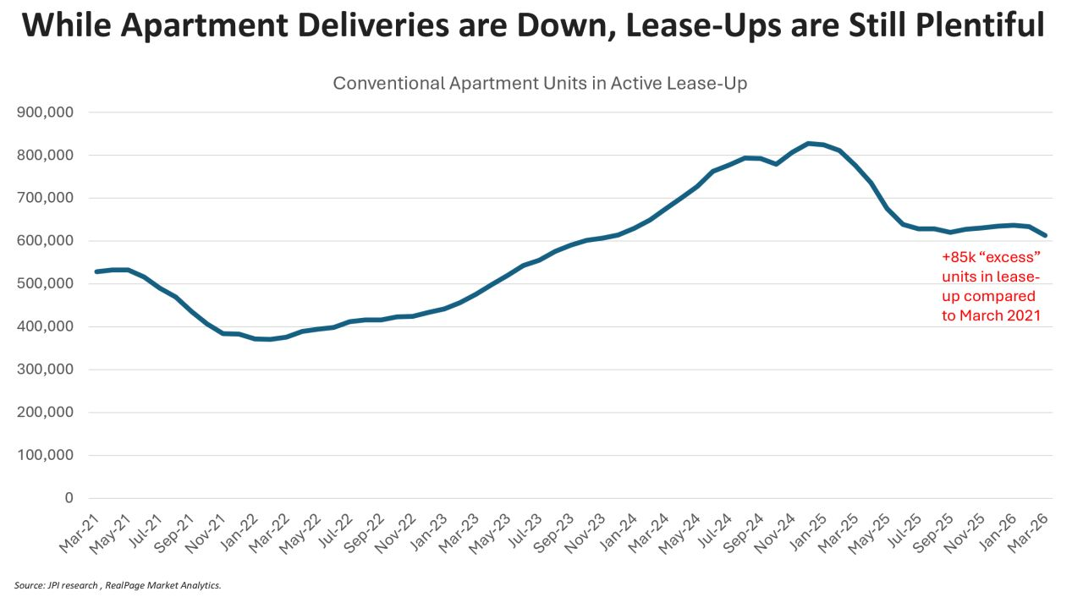
National Snapshot
Notes:
Units in active lease-up – so completed, not yet stabilized, 85,000 units over the stabilized March 2021 before the impacts of COVID
2026, currently tracking to produce 300,000 units
10 year average absorption is 350,000 units
2027 before you will see rents increase due to new product stabilized

Slide 7

Clackamas County
Supporting Housing Production and Meeting State Housing Mandates

Slide 8
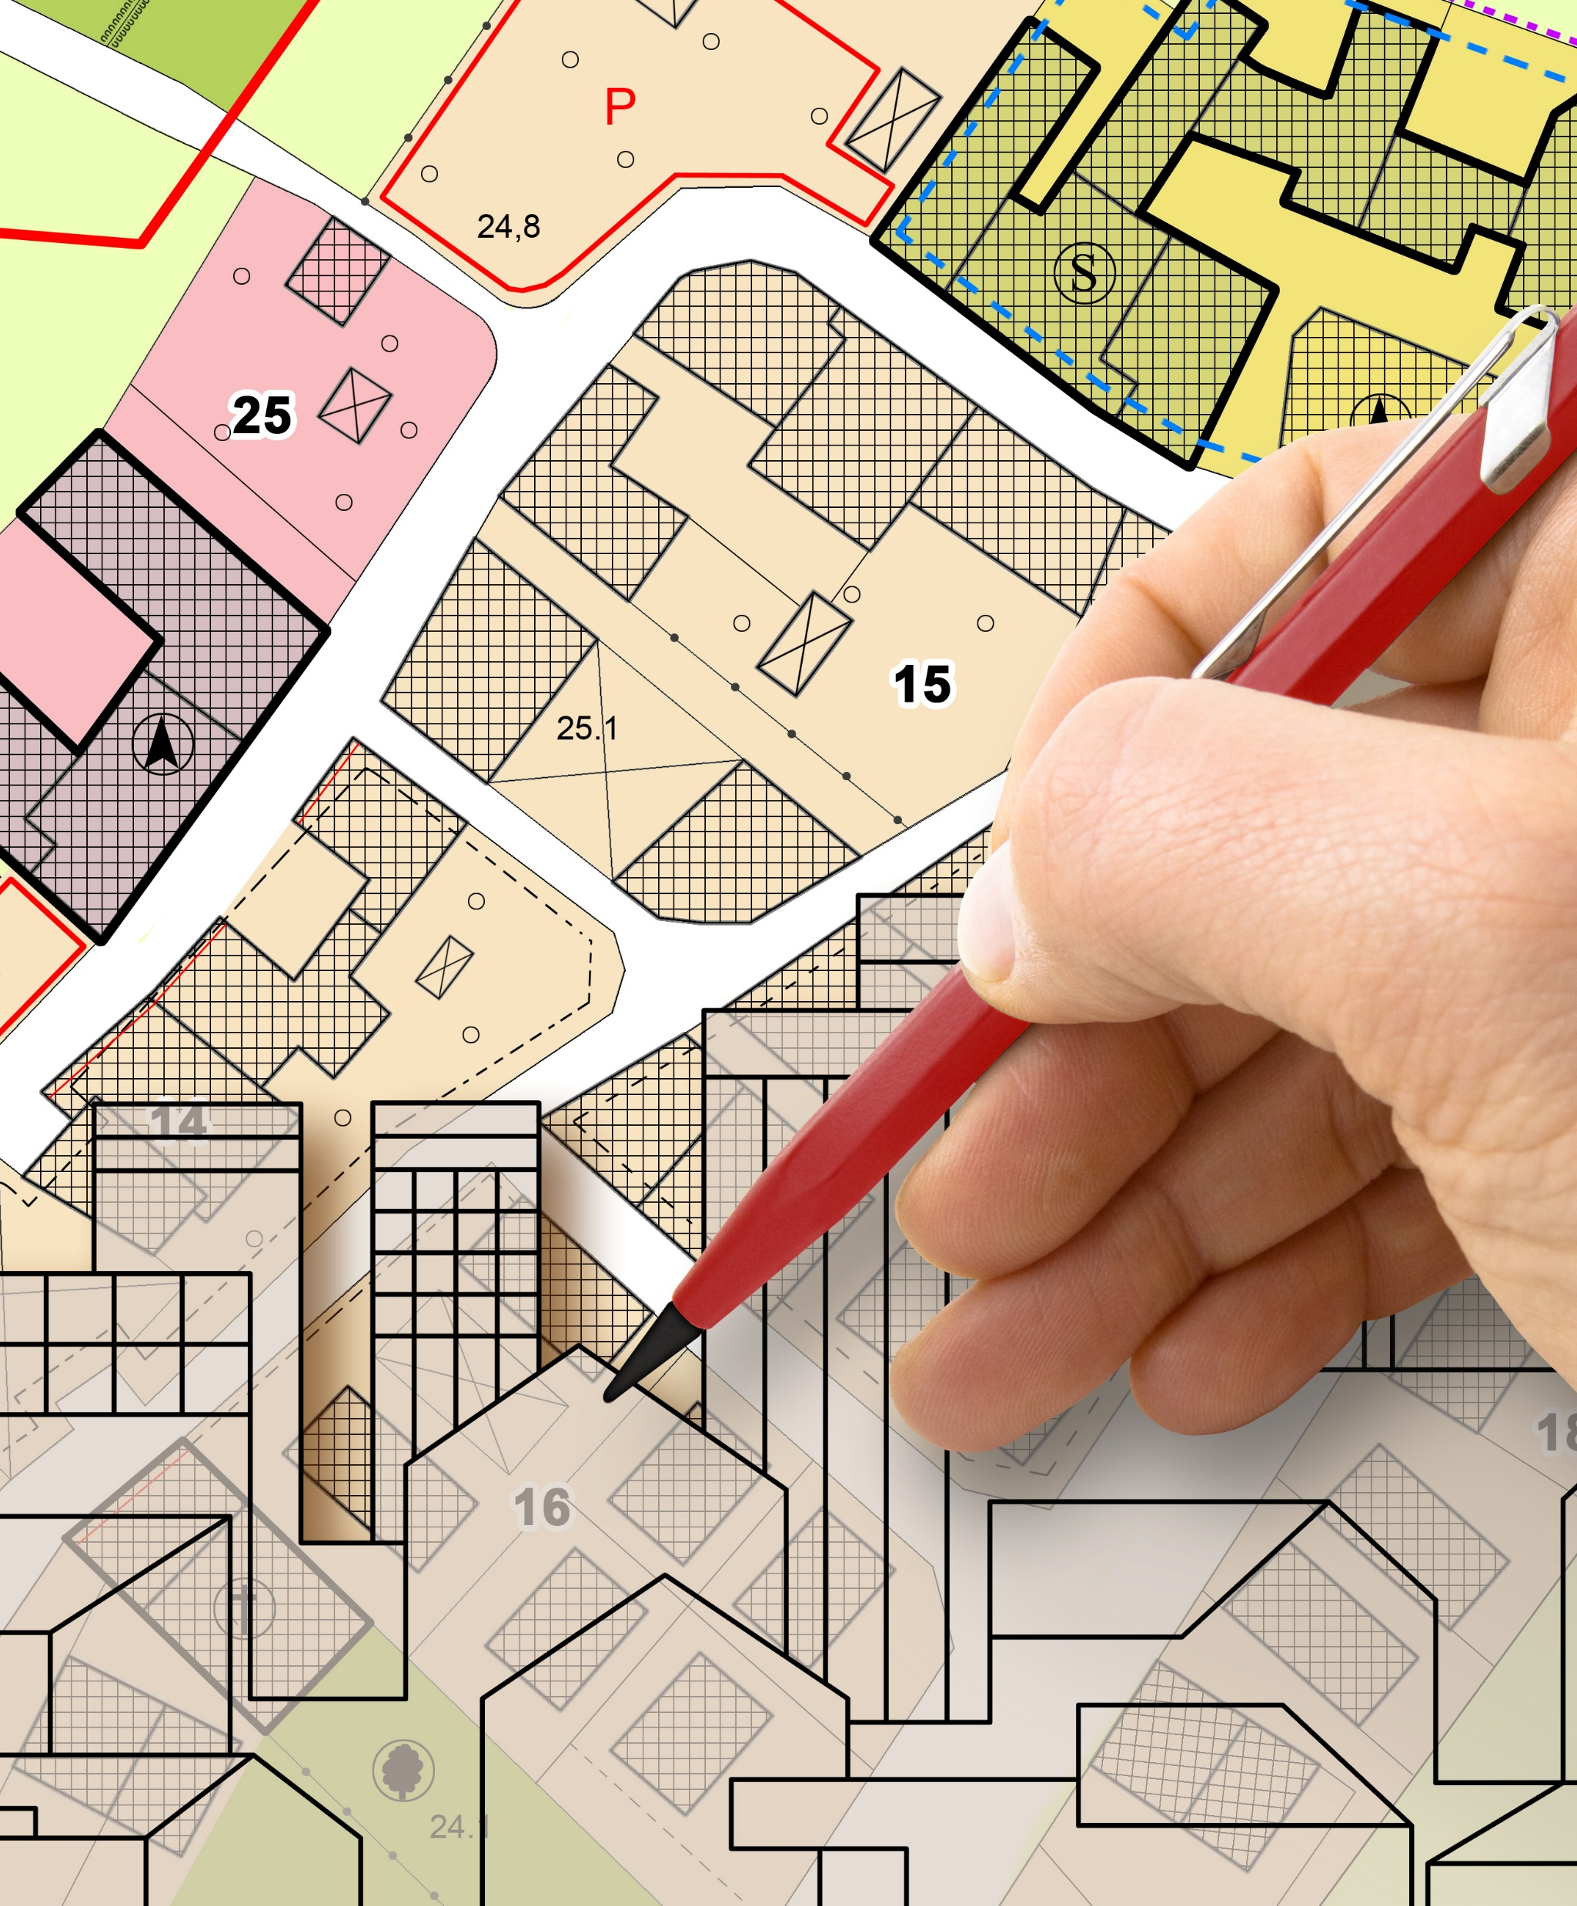
Clackamas County’s approach to housing planning and production
The County is invested in supporting housing production. Planning and Zoning division is working diligently to facilitate housing development and remove barriers to it.

Slide 9
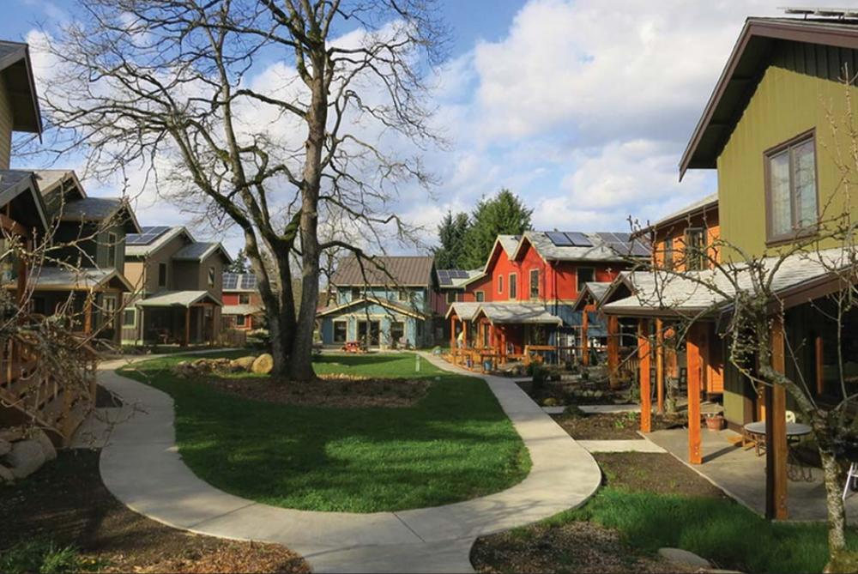
County’s housing production projects:
2020-2023: Housing Strategies Project:
  Phase 1 – Increase density and change parking requirements
  Phase 2 – Allows duplexes, triplexes, cottage clusters, etc.

Slide 10
County’s housing production projects (continued):
2024 & 2026 “Minor and Time Sensitive” Code Amendment Packages
3. 2025 – 2026 Urban Zoning and Development Rules Assessment
  Make the ZDO clearer and easier to use by the public and staff
  Remove barriers to producing housing and buildings for employment
  Bring the ZDO in compliance with state requirements
2025-2027 Clear & Objective Code Amendments
  Goal 5 – Natural Resources, Scenic Areas, and Open Spaces
  Goal 6 – Water Quality
  Goal 7 – Natural Hazards
  Goal 15 – Willamette Greenway
Notes:
In Clackamas County, for 0-2 years old: 23% can access a childcare slot.
For 3-5 year olds, 48% can access a childcare slot.
Source: https://health.oregonstate.edu/early-learners/research/estimated-supply-2024

Slide 11
County’s housing production projects (continued):
2026 – 2027 Implementing Recommendations from ZDO Diagnostic Report
2027 – 2030 Implementing Oregon Housing Needs Analysis (OHNA) Rules

Slide 12
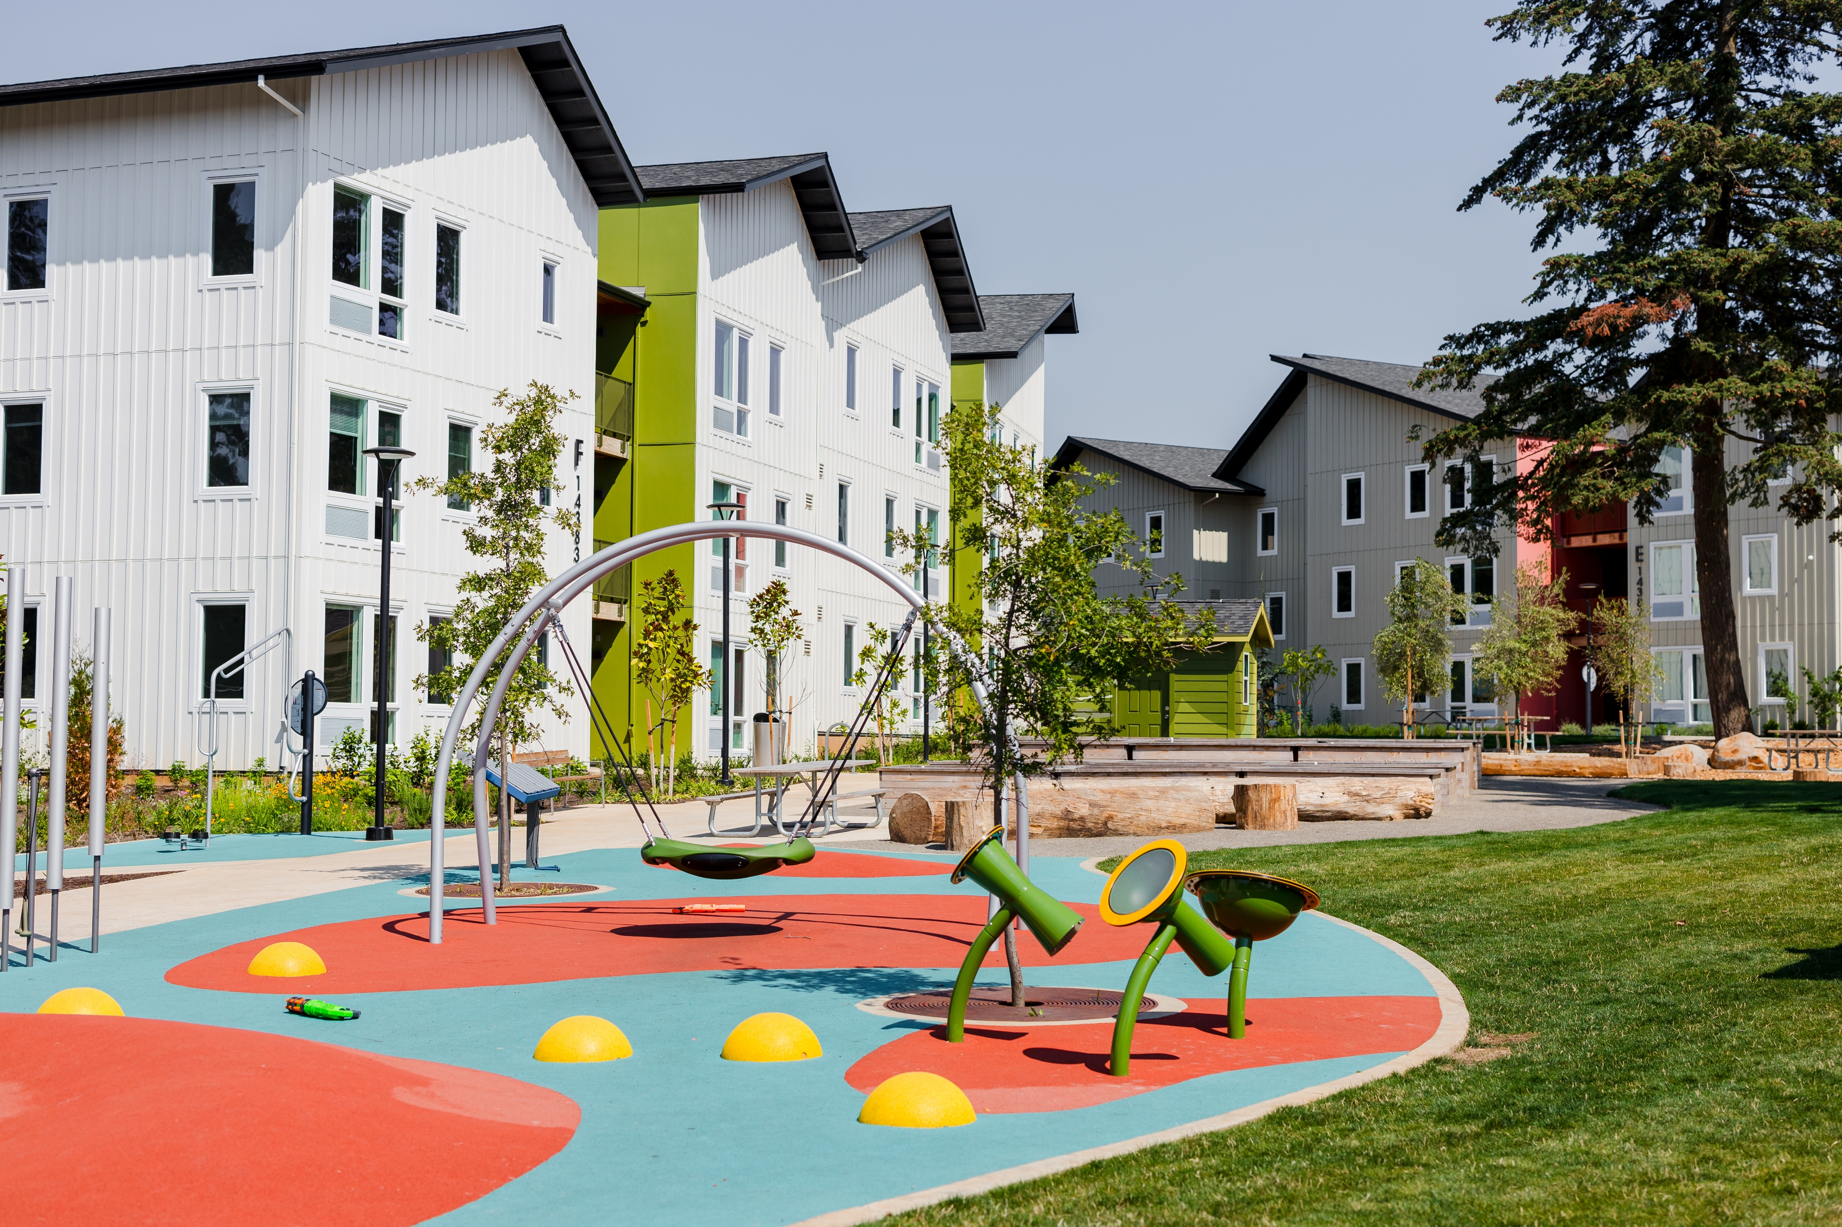
Clackamas County Housing Developments
Using Affordable Housing Bond funds, the County:
Is opening 451 new affordable apartments in 2026, including 52 with support services
And between 2021-2025, has developed 1,170 new affordable apartments, 229 of those with supportive services

Slide 13
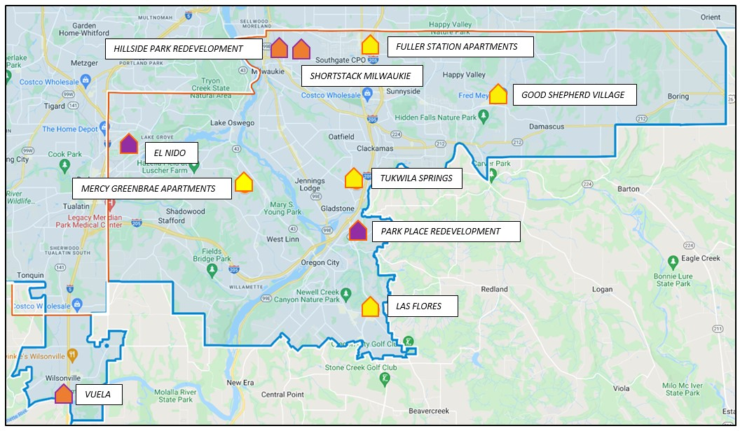

Slide 14
OREGON CITY BUSINESS ASSOCIATION · 2026 HOUSING FORUM
Housing:
Density or Sprawl,
Your Choice.
State Mandates & Local Housing in Clackamas County
City of Oregon City

Slide 15
State
Legislation:
✓ 2 BILLS THAT BUILT HOUSING
HB 2001 — Ended single-family-only zoning
SB 458 — Enabled middle housing land divisions
What Changed
Housing?
→ 81% of Oregon City's 2025 permits were middle housing
⚠ 20+ OTHER BILLS
20+
Changed the process — not yet production
Each bill creates real implementation
burden on local cities
BILLS
SINCE 2019
Monitoring · Code amendments · Staff training

Slide 16
Oregon City's Response
Three mandates. Three actions.
HB
2001
SB
1537
HB
2003
Middle Housing
Code Adopted
Automatic
Adjustments
Housing Capacity
Analysis/Housing Production Strategy
Mandatory permit timelines adopted
Applicants get a decision on schedule
Predictable · Accountable
Obtained waiver from DLCD to maintain our existing variance processes
Ordinance 22-1001 · June 2022
Duplexes · Triplexes · Quadplexes · Cottages in residential zones
The city's next major work program, the Housing Production Strategy follows a six-year housing work plan
All other mandates applied directly — public education provided at oregoncityoregon.gov/housing

Slide 17
Housing By the Numbers: The Shift to Middle Housing
From single-family dominance to missing middle · Oregon City · 2015–2025
HB 2001
takes effect
81%
of 2025 permits
were middle housing
vs. 0% in 2021
234
middle housing
permits in 2025
vs. 0 in 2019
10×
growth in Middle
Housing Land Divisions
2 in 2022 → 23 in 2025
Middle Housing = duplexes · triplexes · quadplexes · cottage clusters | Source: Oregon City Community Development, 2015–2025

Slide 18
Oregon City's Housing Future
Step 1: Housing Capacity Analysis → Step 2: Housing Production Strategy
1
Housing Capacity Analysis (HCA)
How much housing can Oregon City realistically accommodate?
Land capacity · Infrastructure constraints · Overlay districts · State-set targets
▼
2
Housing Production Strategy (HPS)
Oregon City's 6-year housing work plan — adopted by City Commission
📋 Regulatory Actions
💡 Incentive Programs
🤝 Investment & Partnership

Slide 19
The Bottom Line
STATE
CITY
AHEAD
2 Bills
Code
Adopted
6-Year
Plan
HB 2001 + SB 458
Directly changed what
gets built — the data
proves it.
HB 2001 · SB 1537
Implemented on time.
Public education for
all other mandates.
HCA → HPS → SDC Reform
Building the financial
and regulatory foundation
for what comes next.
SDC tiering and deferral to Certificate of Occupancy — in development now to make middle housing pencil out financially

Slide 20


About the HBA
6 counties, 40 cities
Represent 600+ residential construction industry professionals:
  Infill
  Multifamily
  Production home builders
Government Affairs: Partner with cities, counties, elected officials, and other stakeholders to promote and provide diverse housing options throughout our region

Slide 21
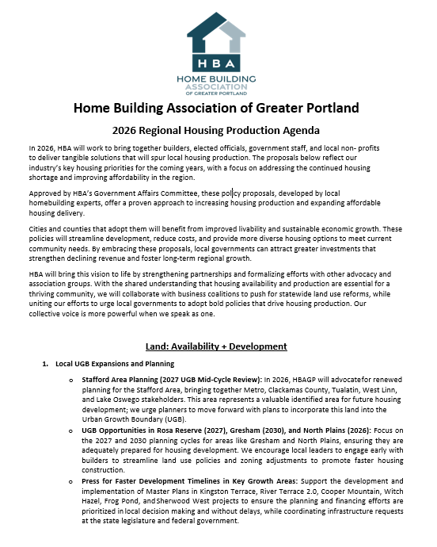
HBA Policy Priorities
Land Availability & Development
  Accelerated development timelines
  Clarity on upcoming UGB expansions
Time: Permitting & Efficiency
  Clear goals & timelines for residential permits
  Reduced threshold for small-scale & remodeling permits
Cost: Affordability & Fees
  SDC Deferral Reform
  SDC Increases tied to
  TIF Flexibility

Slide 22
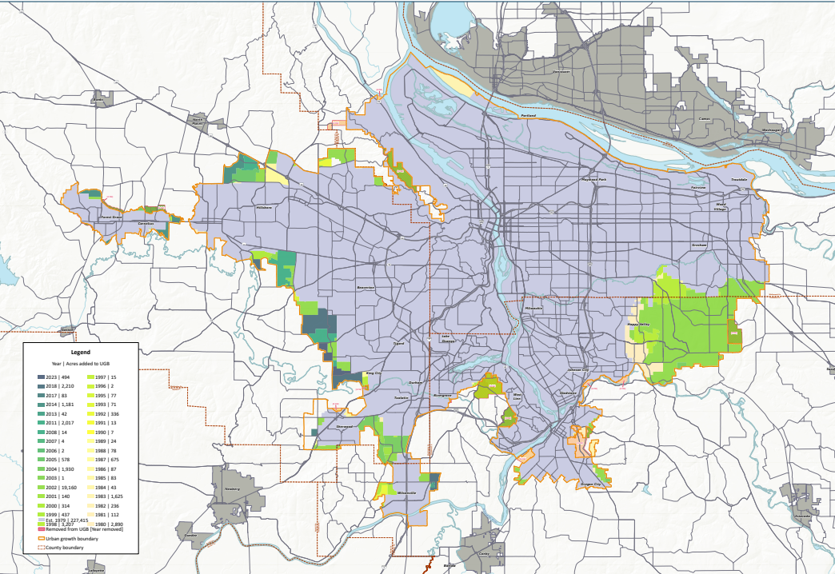
Land Supply & Planning Timelines
Construction Underway:
Kingston Terrace (King City):
Planning Complete:
Cooper Mountain (Beaverton)
Frog Pond East/South (Wilsonville)
Pleasant Valley/North Carver (Happy Valley)
Planning Underway:
Sherwood West
River Terrace 2.0 (Tigard)
Map: Metro, 2025

Slide 23
Cost: Total Single Family SDCs 2016 vs. 2026
*Based on a 2,000 sq. foot single family detached home

Slide 24
Legislation and Policies to Watch
SB 974 (2025):
  Engineering plans reviewed for completeness within 30 days, final decision within 120 days
  Removes residential design standards for housing developments of 20 or more units
HB 4035 (2026): Revamped one-time UGB expansion
  Cities with a population greater than 25,000
    Up to 150 net residential acres
  Cities with a population less than 25,000
    Up to 50 net residential acres
HB 4037 (2026):
  Reduced notice & hearing requirements
  Self certification options for certain building plans
The Role of the Housing Accountability & Production Office
  Clarity around unnecessary cost or delay

Slide 25
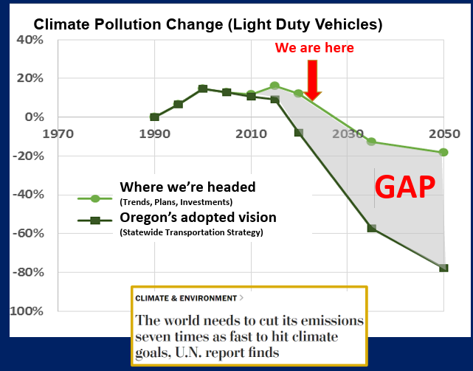
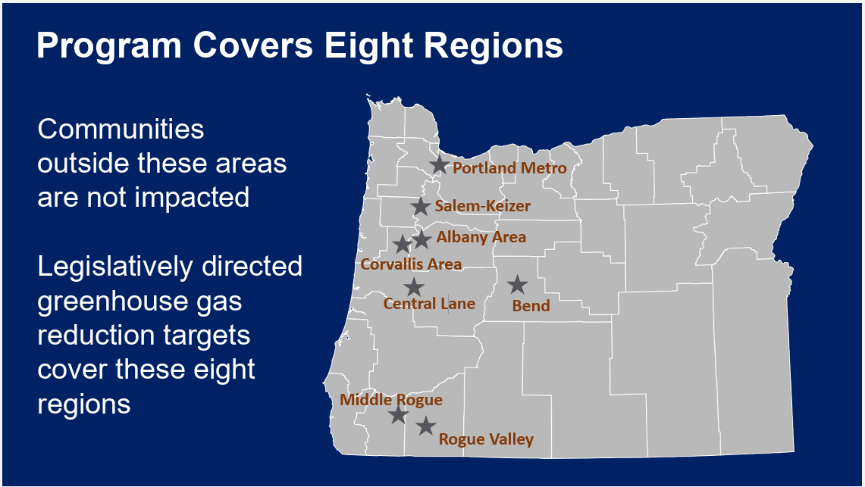
Climate Friendly and Equitable Communities (CFEC) – Department of Land Conservation and Development (DLCD)
No minimum parking requirements within ½ mile of frequent transit corridors.
Electrical infrastructure for 40% of stalls.
Notes:
In 2007, Oregon legislators adopted a law setting a state policy and goal to reduce Oregon’s climate pollution by 75% by 2050.
Transportation is responsible for 36 or 38% depending on where you look in the data.

Slide 26
HB 4037 – Review of Housing Applications (ORS 197A.400)
(5) For applications subject to subsection (1) of this section, the local government:
(a) May provide notice of the application only to owners of record of property on the most recent property tax assessment roll where such property is located within 100 feet, or within 500 feet for developments of 20 units or more, of the property that is the subject of the notice;
(b) May not require a public hearing prior to making a decision on the application; and
(c) May provide an opportunity for a local appeal only to the applicant.
(6) Notwithstanding ORS 197.825, only the applicant may appeal a decision made under subsection (5) of this section to the Land Use Board of Appeals. SECTION 18. The amendments to ORS 197A.400 by section 17 of this 2026 Act become operative on July 1, 2026.
Notes:
Senate, 28-2 (Neron Misslin, Robinson), House, 52-1 (Rieke Smith), June 5, 2026 effective date

Slide 27
HB 3746 – Statute of Repose for Condos
(4) Notwithstanding subsection (2) of this section, the period of limitation for a tort action by a homeowners association or association of unit owners arising from the defective construction, alteration or repair of a structure or unit is: (a) Seven years after substantial completion or abandonment of the construction, alteration or repair of the structure; or (b) If a construction defect described in this subsection is discovered more than six but less than seven years after substantial completion or abandonment, one year after discovery of the defect.
Notes:
Effective January 1, 2026

Slide 28
SB 426 – Wage Theft
(2) An owner that enters into a construction contract with a direct contractor shall be jointly and severally liable with the direct contractor for any unpaid wages, including fringe benefit contributions and penalties, owed to any unrepresented employee of the direct contractor and any unrepresented employee of a subcontractor at any tier for labor performed on a project within the scope of the construction contract.
Notes:
Effective January 1, 2026. House, 31-26, Senate, 17-12.

Slide 29
SB 1566 – Prevail Affordable Projects
Digest: Says that a public agency does not need to set a certain wage level for a project that is affordable housing. (Flesch Readability Score: 60.6). Exempts certain projects for public works, primarily related to affordable housing, from the requirement to pay a prevailing rate of wage. Takes effect on the 91st day following adjournment sine die.
ORS 279C.810(1)(a)(H) provides an exemption for loans made by the state to a private party with the proceeds derived from the sale of bonds.
Notes:
Labor commissioner, Christina Stephenson.
Eugene Downtown Riverfront Development,
Cash cap of $749,999 – has not been changed in decades

Slide 30
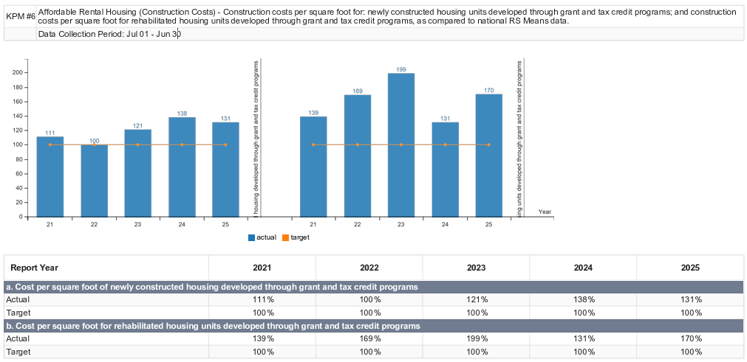
Housing and Community Services Department – 2025 Annual Performance Progress Report
Notes:
From July 1, 2024 through June 30, 2025, the average cost per square foot of new construction properties that completed construction during that period was $318, or 131% of the combined 2024 and 2025 national average construction costs per square foot as reported by RS Means data ($242). This is above the target of 100%, which is a negative result. For properties that were preserved and went through significant rehabilitation, the average cost per square foot of that rehabilitation was $197, which is 170% of the combined 2024 and 2025 national average rehabilitation costs per square foot as reported by RS Means data ($115). This is above the target of 100%, which is a negative result.
From July 1, 2024 through June 30, 2025, the average cost per square foot of new construction properties that completed construction during that period was $318, or 131% of the combined 2024 and 2025 national average construction costs per square foot as reported by RS Means data ($242). This is above the target of 100%, which is a negative result. For properties that were preserved and went through significant rehabilitation, the average cost per square foot of that rehabilitation was $197, which is 170% of the combined 2024 and 2025 national average rehabilitation costs per square foot as reported by RS Means data ($115). This is above the target of 100%, which is a negative result.

